Slide 1
Bringing ML to Mobile Apps – Let’s build an app to perform Face Recognition using Flutter
Don Ward
Quicken Loans
Senior Research Engineer
donward@quickenloans.com
@donwardpeng

Slide 2
Who should be here?
Notes:
Know a programming language.
People who enjoy curly braces.
Introductory course - no authors
No need to have done mobile development
Admin access on PC.
Ideally, have heard of Flutter, and want to learn it.

Slide 3
The Agenda
Flutter
What, why, how
Dart
What, why, how
What are we building today?
What does it use?
Let’s setup our environments!

Slide 4
Do you want to build amazing apps for multiple screens from one codebase?

Slide 5

Stable
‘Stable-ish’
Working On
Notes:
iOS and Android – Stable
Web – Beta
macOS – Alpha
Windows and Linux – Technical Preview

Slide 6
Who is using it?

Slide 7
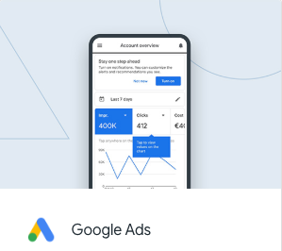

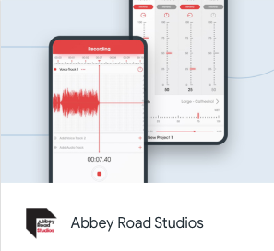
Early Adopters

Slide 8
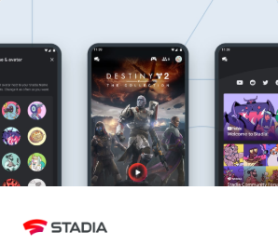
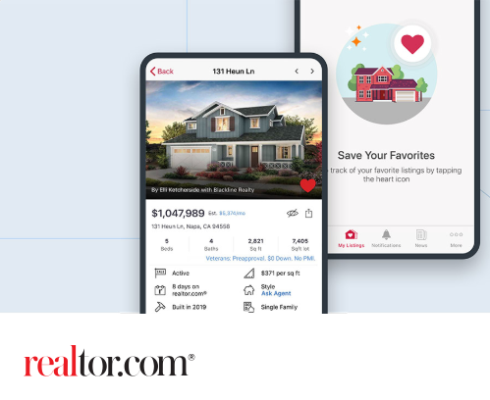
More recent adopters

Slide 9
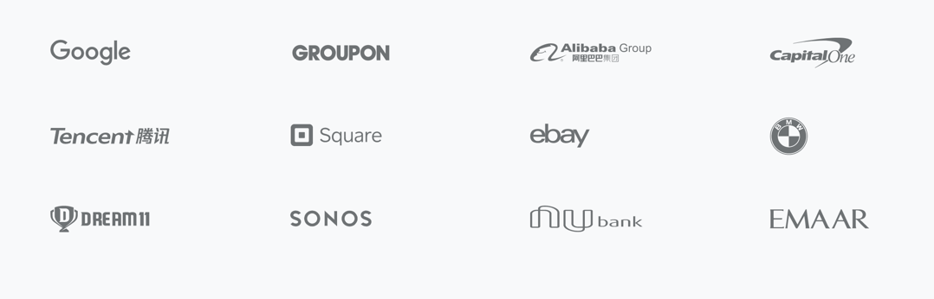
And some more...

Slide 10
What about Apple and their store review/approval process?

Slide 11
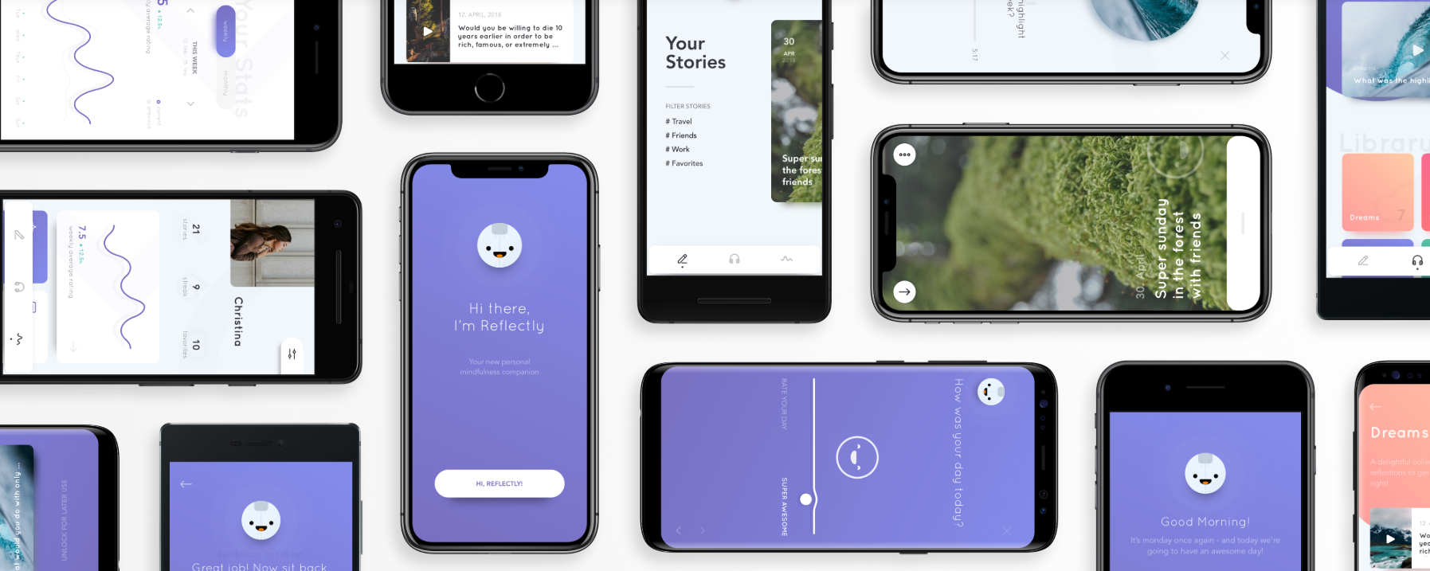
Notes:
One last story – Reflectly.
How many of you have ever heard of Reflectly? They build a journal and diary app for Android and iOS.
They have been around for a few years (since 2017), and are quite popular in the space.
Earlier this year they re-wrote their app from React Native and in Aug 2019 they were featured in the Apple app store as the app of the day.

Slide 12
Notes:
So what makes Flutter different?

Slide 13
Native Mobile Apps
Notes:
Native Mobile apps use Native Code to communicate with the underlying native Widgets from Google and Apple.
The Widgets then draw themselves on the screen using a canvas and handle incoming events with handlers.
Accessing platform services, like location data, Bluetooth connectivity, and audio are communicated to via your native code.

Slide 14
PhoneGap, Cordova, Ionic and WebView based Systems
Notes:
So after Apple first released the iPhone and iPad, and before they had an SDK they suggested 3rd party apps be written for WebvVews.
PhoneGap, Cordova, Ionic and other WebView based Systems for mobile development took this approach.
So the premise is, you write your app in HTML and other web languages, and your app is hosted in a Webview Widget on the platform. It controls the canvas and elements in the Widget.
If you want to work with platform services you use a bridge between JavaScript and native services.
A few advantages of this,
You use Javascript and other standardized web languages to create your app – so lower barrier to entry.
You Javascript is portable.
A few disadvantages – Javascript runs in it’s own realm, and native runs in it’s own realm. Both run fast in their own realm, but the bridge does not necessarily run quickly.

Slide 15
React Native
Notes:
React Programming has become very popular.
In 2015 Facebook released React Native adding React Programming concepts to the JavaScript and Webview model used earlier.
With a React Native app, you create your app in JavaScript and there is a bridge between the JavaScript and Native realms. Your JavaScript app holds a DOM for the elements on the screen and the bridge communicates that DOM to the native platform.
React Native is hugely popular since it allow for web style programming using reactive elements on mobile.
As you can see the bridge is used not just between the platform services, it is also used to communicate to the native widgets on the platforms.
For things like animations, transitions and user swipes the bridge can be limiting. JavaScript runs fast in it’s realm, and native components run fast in their realm, but the bridge does not necessarily run fast.

Slide 16
Flutter
Notes:
This is where Flutter entered the scene.
Flutter’s rendering was initially an experiment by the Chrome team to see how they could render elements more quickly on websites.
In Flutter, there is no bridge. This is the major difference that leads to 60 frame/second performance.
The Flutter framework controls the rendering of all widgets directly on the canvas as well as handling of all events. For example, in Native Code, an iOS widget is drawn and created by the platform when one is created in your native app. The drawing and event handling is done by the platforms widget library.
In Flutter, the framework draws the widget and handles events. For instance an iOS button and an Android button in Flutter are drawn on a blank canvas by the Flutter framework. They duplicate the exact functionality and are pixel perfect representations of the native widgets, they are just controlled by the Flutter framework.
This allows for quick updates of the UI since the Flutter framework can control what sections of the screen to redraw as well as what sections do not require a redraw.
Additionally to communicate with Platform Services like Location, Bluetooth, etc. the Flutter framework uses Platform Channels which call directly into the native platform code to control these.
All of this from one codebase for both iOS and Android.

Slide 17
Notes:
So what does Futter code look like? Let’s take a quick look.

Slide 18
new Center( child: new Column( children: [ new Text('Hello, World!')), new Icon(Icons.star,
color:Colors.green) ] ) )
Notes:
Read this over – what do you think it draws on the screen?

Slide 19
Notes:
Here it is. A centered column with the text ‘Hello World’ and an green star icon underneath it.

Slide 20



Slide 21
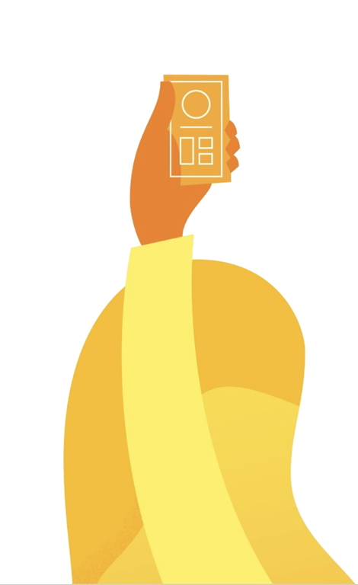
‘Why Dart?’

Slide 22
Need next slide!

Slide 23
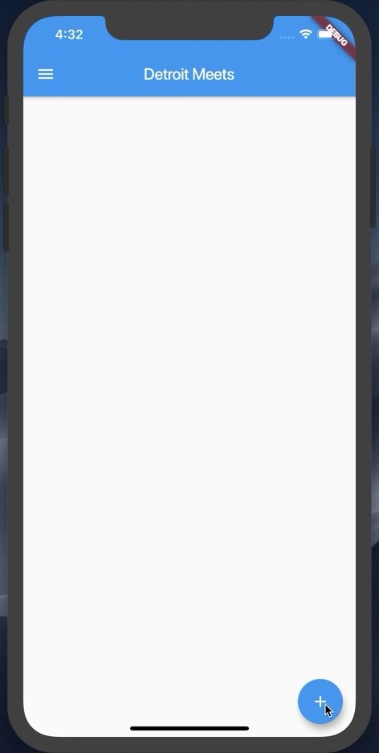
What are we building today?

Slide 24
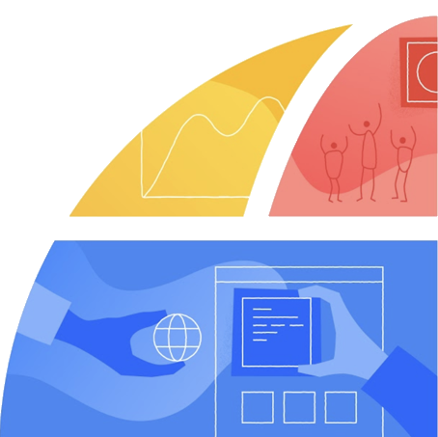
Let’s setup your environment!

Slide 26
Let’s start
Flutter SDK installed
Visual Studio Code installed
Android emulator or iOS simulator running
http://bit.ly/detroitmeetsflutter

Slide 27
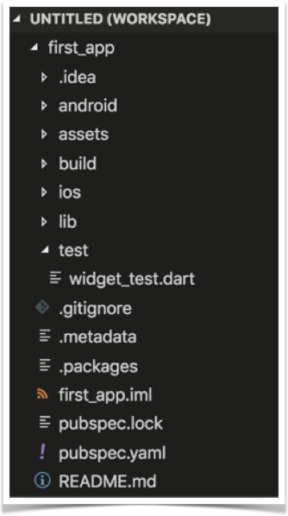
Project Structure

Slide 28
Let’s start from scratch
In VS Code, open the main.dart file
Wipe it clean
Add the code below
//Example 1
import 'package:flutter/material.dart';
void main() {}

Slide 29
Let’s attach something to the screen
The runApp method
In Dart, ‘=>’ is equivalent to {return expr};
//Example 2
import 'package:flutter/material.dart';
void main() => runApp(<Widget>);

Slide 30
‘Let’s talk about Widgets’

Slide 31
Widgets
Everything is a widget
Stateless Widgets
Stateful Widgets
class StatelessWidgetExample extends StatelessWidget{};
class StateFullWidgetExample extends StatefulWidget{};

Slide 32
Let’s create our first Widget
//Example 3
import 'package:flutter/material.dart';
void main() => runApp(MyApp());
class MyApp extends StatelessWidget{
@override
Widget build(BuildContext context) {
// TODO: implement build
return null;
}
}

Slide 33
Let’s add some Material Design
//Example 4
@override
Widget build(BuildContext context) {
return MaterialApp(
title: ‘CUCSC Conference’,
);
}
}

Slide 34
‘Exciting Stuff! Let’s talk about Constructors!’

Slide 35
Widgets & Constructors
Positional and Named Parameters
Named Parameters declared with {}

Slide 36
The Text Widget
Text(String data, { Key key, TextStyle style, StrutStyle strutStyle, TextAlign textAlign, TextDirection textDirection, Locale locale, bool softWrap, TextOverflow overflow, double textScaleFactor, int maxLines, String semanticsLabel })

Slide 37
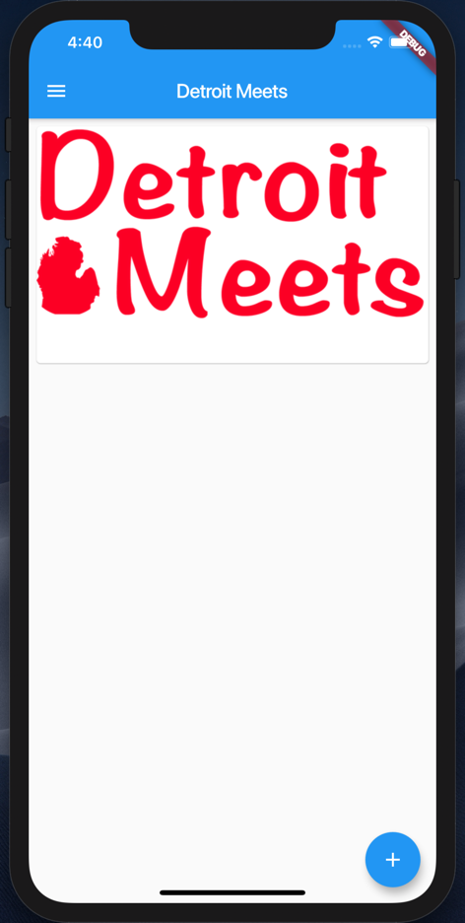
Let’s add some Widgets
Add a Card per Image
Add a Floating Action Button

Slide 38
Add a Scaffold for the Screen
//Example 5
return MaterialApp(
title: Detroit Meets',
home: Scaffold(
appBar: AppBar(
title: Text(‘Detroit Meets'),
),
));

Slide 39
Add a Card to the Body
//Example 6
home: Scaffold(
appBar: AppBar(title:Text(‘Detroit Meets’),),
body: Card(child: ,));
}
}

Slide 40
Add a Column to the Card
//Example 7
... appBar: AppBar(
title: Text(‘Detroit Meets’),
body: Card(child: Column(children: <Widget>[],),
),
));
}...

Slide 41



Let’s add some images
Steps:
Create a new assets folder and add images
Modify pubspec.yaml file

Slide 42
Add a Image to the Card
//Example 8
...
child: Column(
children: <Widget>[
Image.asset(‘assets/detroit_meets.jpeg'),
],
),...

Slide 43
Guess what – Padding is a Widget
//Example 9
Below the Image...
Padding(padding: const EdgeInsets.all(8),
),
],
),
)));...

Slide 44
Margin is inside a Widget
//Example 10
...
body: Card(
margin:EdgeInsets.all(8),
child: Column(
children: <Widget>[
Image.asset(‘assets/detroit...'),
...

Slide 45
ListViews give us scroll
//Example 11
...
body: ListView(
children: <Widget>[
Card(
margin: EdgeInsets.all(8),
child: Column(
...

Slide 46
Let’s add a Floating Action Button
//Example 12
...
body: ListView(children: <Widget>[
...
floatingActionButton: ,));

Slide 47
Let’s add a FAB object
//Example 13
...
floatingActionButton: FloatingActionButton(
child: const Icon(Icons.add),),
));

Slide 48
onPressed() for the FAB
//Example 14
floatingActionButton: FloatingActionButton(
child: const Icon(Icons.add),
onPressed: () {}),
));

Slide 49
Everything is in place now. Let’s wire up the button and images to the list.
WARNING: BOILERPLATE CODE AHEAD

Slide 50
Let’s add a list of Images
//Example 15
class MyApp extends StatelessWidget {
// Declare a set list of images to cycle through
final List<Image> _itemImages = [
Image.asset('assets/detroit_cityscape.jpg'),
Image.asset('assets/detroit_meets.jpeg'),
Image.asset('assets/tigers-d.jpg')
];
int _index = 0;
List<Image> _listOfImagesForScreen = [];

Slide 51
Boiler Plate Alert – A Stateful Class
//Example 16
class MyApp extends StatefulWidget {
@override
State<StatefulWidget> createState() {
return _MyAppState();
}
}
class _MyAppState extends State<MyApp> {

Slide 52
Let’s make the button do something
//Example 17
//Add to the main class above the build method
void onButtonPressed() {
setState(() {
_index++;
if (_index >= _itemImages.length) {
_index = 0;
}
_listOfImagesForScreen.add(_itemImages[_index]);
})}

Slide 53
Update the ListView
//Example 18
home: Scaffold(
appBar: AppBar(
title: Text('Detroit Meets'),
),
body: ListView(
children: _listOfImagesForScreen
.map((element) => Card(
margin: EdgeInsets.all(8),

Slide 54
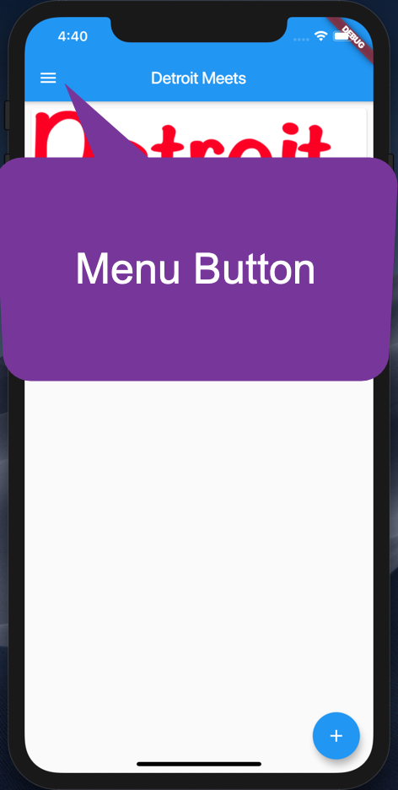
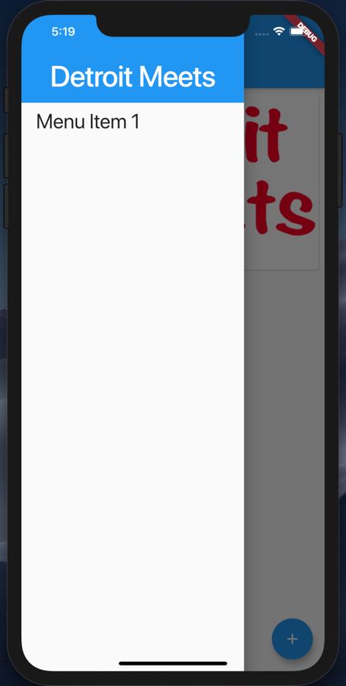
Let’s add a Nav Drawer

Slide 55
A simple Nav Drawer
//Example 19
drawer: Drawer(
child: ListView(
padding: EdgeInsets.zero,
children: <Widget>[
Container(
height: 128.0,
child: DrawerHeader(
child: Text(
'Detroit Meets',
...

Slide 56
What did we learn?
Command Line Tool for Flutter
Project Structure
Widgets
Constructors and Named Parameters
Stateless and Stateful Widgets
A few Widgets ☺
http://bit.ly/detroitmeetsflutter

Slide 57

Thank you!
Don Ward
Quicken Loans
Senior Research Engineer
donward@quickenloans.com
@donwardpeng

